Slide 1
Introduction of IBS Vietnam
June 2015
Intelligence Business Solutions Vietnam Co., Ltd.

Slide 2
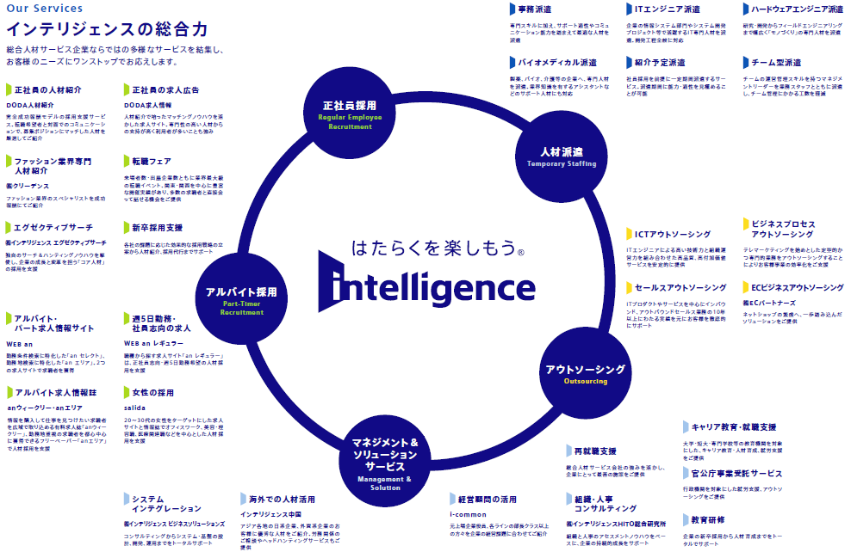
What is “Intelligence Business Solutions”?
IBS provides system integration service for Intelligence group and the other clients.
Intelligence Business Solutions

Slide 3
IBS history in Vietnam
IBS deal with system development in Vietnam from 2009. Finally we established our own company in Vietnam last year.
IBS history in Vietnam
Mar, 2009
May, 2010
Jan, 2011
Feb, 2011
Mar, 2011
May, 2013
Oct, 2013
Made a partnership with local IT company in Vietnam
Started INTE OS system development
Offshore Development Center started
Started INTE OS system maintenance
Started INTE Media system maintenance
Started INTE Career system maintenance
Started AEON Accounting system maintenance
Global team system development model started
Established IBS Vietnam
Using partnership
Trying global team
Development model

Slide 4

What is “Global Team System Development”?
In Global Team System Development, we communicate in English and high power network communication tools. Therefore we don’t have to care place of work in the world.
As usual offshore model
Global Team Model
Client
Client
English communication
PM
（Japan）
（e.g. Philippines）
RD / Design
（Japan）
PM
SE
SE
SE
SE
SE
Japanese
translate
BSE
Programming
（Vietnam）
SE
SE
SE
SE
SE
SE
（Vietnam）
Divided team
Narrow communication using translator
Don’t divide project
Wide communication in English

Slide 5
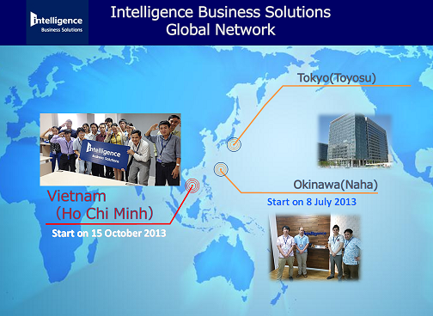
Another purpose of Global Team System Development
In 10 years, IT system development industry will be change to global. IBS is still domestic company. We might be change faster. IBS Japan have to improve global skills with high performance Asian country’s IT engineers.
Offices
Roles
IBS
（HQ）
Communication with client in Japanese
Client requirement development and business design
Focus to client
IBS
Okinawa
Global team project management
Standardization of system development in IBS global
Global project
management
IBS
Vietnam
Development high quality IT systems
Make succeed and expand another Asian country

Slide 6
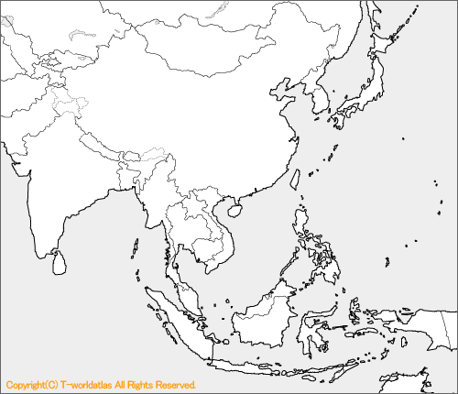
Future plan of IBS global team
IBS already have 3 office. And in 5 years we open more than 5 offices in Asia.
Tokyo
Dhaka
Okinawa
Yangon
Manila
Bangalore
Cebu
Jakarta
Ho Chi Minh

Slide 7
Vision of IBS Vietnam in 3 years
In 3 year, we become 200 employees size company. And we deal with Japanese and the other countries client in Asia. And also we focus on IT service quality. IBS Vietnam define it “Client Satisfaction”.
Large
Vision
Jan, 2017
200 employees
40 Projects
$730,000 profit
200 employees (1 Chairman, 1 general director, 1 general manager, 3 division manager, 10 project manager, 10 business analyst, 10 Technology architect, 5 administrator, 120 senior developer, 40 programmer)
40 Projects (More than 40 projects running at the same time)
$726,000 operating profit in FY17 (90% of sales from Japan, 10% sales from South East Asia)
Business Size
Jan, 2014
25 employees
5 Projects
1 local service
Small
Normal
IT Service Quality
(= Project succeed)
High

Slide 8

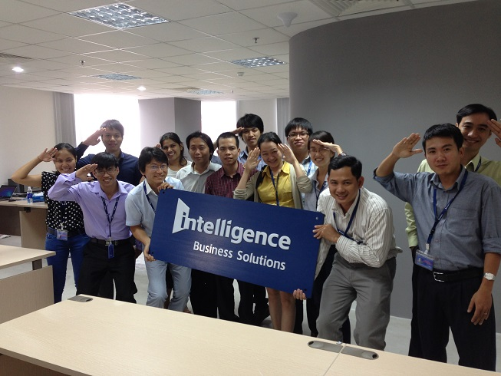

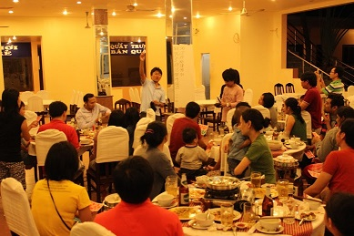
Closing
Difference of between own company and outsourcer is “we can install INTELLIGENCE culture or not”. These days, our staff in Vietnam started to use our slogan “Your Job Your Joy” by themselves.
Slogan
This slogan (literally, “Your Job, Your Joy”) expresses our “Positive work choices for everyone” brand vision. Through professional support, we aim to transform employment into a positive experience for individuals and companies.
Logo
Our Door of Intelligence logo symbolizes the promise of our brand. It inspires customers and staff members to open the door to new possibilities and step toward a brighter future.

